Slide 1
Data Exploration FOR Titanic database
Data ANALYSIS
Project 1:

Slide 2
TABLE OF CONTENT
Business context
Technical context
01
02
Tables & fields
Free exploration
03
04
Data ANALYSIS
The background and context of the database
Technical aspects of the database
Understanding the database using SQLite
The conclusions made from the studies of the dataset

Slide 3
01
Business context
MENU
ANALYSIS
CONTACT
Data ANALYSIS
Titanic Database
The background and context of the database

Slide 4
Business context
Data ANALYSIS
What is the cause of the dataset existed?
A tragic accident happens on 15 April 1912, where the RMS Titanic sunk in the North Atlantic Ocean, after it collided with an iceberg during its journey to New York City from Southampton.
What is the used of this dataset?
The dataset provides the necessary information to predict the fate of the passengers on the Titanic.
What is titanic data analysis?
The total samples are 891 or 40% of the actual number of passengers on board the Titanic.

Slide 5
02
Technical context
MENU
ANALYSIS
CONTACT
Data ANALYSIS
Titanic Database
Technical aspects of the database

Slide 6
technical context
Data ANALYSIS
Where are the source of the data?
The principal source for the data about the Titanic passengers is the Encyclopedia Titanica.
What are the errors of this dataset?
The data contains empty data fields.
How are the data collected?
The datasets are collected from a variety of investigators and researchers.

Slide 7
03
Tables & fields
MENU
ANALYSIS
CONTACT
Data ANALYSIS
Titanic Database
Understanding the database using SQLite

Slide 8
The tables and and fields
PassengerId
Survived
Pclass
Name
Sex
Age
Data ANALYSIS
The Titanic database have one table, called passengers. The columns in this table are:
Definition: Id of each passngers Type: Integer
Definition: Survival Type: Integer
Definition: Ticket Class Type: Integer
Definition: Passenger’s name Type: Text
Definition: Gender Type: Text
Definition: Age in years Type: Text

Slide 9
The tables and and fields
SibSp
Parch
Ticket
Fare
Cabin
Embarked
Data ANALYSIS
The Titanic database have one table, called passengers. The columns in this table are:
Definition: Number of siblings/spouse aboard Type: Integer
Definition: Number of parents aboard Type: Integer
Definition: Ticket number Type: Text
Definition: Passenger fare Type: Integer
Definition: Cabin number Type: Text
Definition: Port of embarkation Type: Text

Slide 10
04
Free exploration
MENU
ANALYSIS
CONTACT
Data ANALYSIS
Titanic Database
The analysis and the conclusions made to the database

Slide 11
Research questions
Data ANALYSIS
In the movie, the children, elderlies and females can get onboarded to the rescue boat first, so Are children and elderlies have a high survival rate in this accident? Are females more likely to survive in this accident than males?
Are rich people have a survival rate because they can get onboard to the rescue boat sooner?

Slide 12

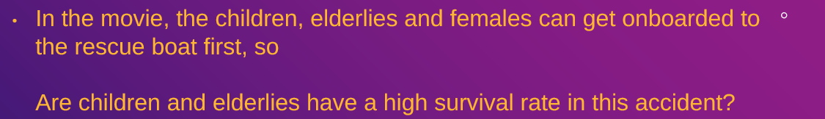


Output
SQL Query
This SQL query count the number of passengers that are children and elderlies that survived the incident.

Slide 13


Output
SQL Query
This SQL query count the number of passengers that are children and elderlies who did not survived.

Slide 14
Data exploration
Data ANALYSIS
In the movie, the children, elderlies and females can get onboarded to the rescue boat first, so Are children and elderlies have a high survival rate in this accident? In this analysis, passengers with the age less than 13 years old is considered as a child, while passengers with the age of 65 or higher is considered as an elder. From the analysis, it can be concluded that, there is only 20 passengers in the group of children and elderlies that survived out of 47 passengers which makes the group have a survivability rate of 42.55%.

Slide 15


Output
SQL Query
This SQL query count the number of passengers that are females that survived the incident.

Slide 16
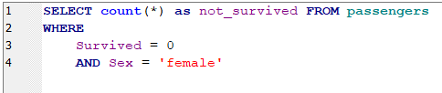

Output
SQL Query
This SQL query count the number of passengers that are females who did not survived.

Slide 17


Output
SQL Query
This SQL query count the number of passengers that are males that survived the incident.

Slide 18


Output
SQL Query
This SQL query count the number of passengers that are males who did not survived.

Slide 19
Research questions
Data ANALYSIS
In the movie, the children, elderlies and females can get onboarded to the rescue boat first, so Are females more likely to survive in this accident than males? From the analysis, 233 out of 314 female passengers have survived the incident, which makes the survival rate of 74.2%. As for the males, 109 out of 577 passengers have survived the incident. From that, the survival rate is 18.9%. It can be concluded that the female passengers will be more likely to survive than the males.

Slide 20
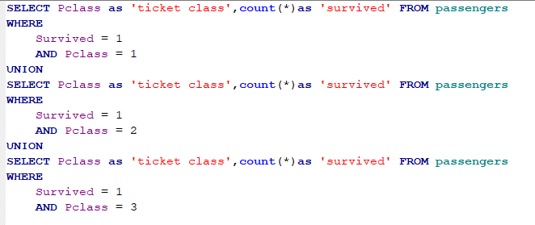
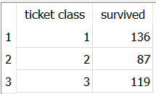
Output
SQL Query
This SQL query count the number of passengers from each ticket class that survived the incident.

Slide 21
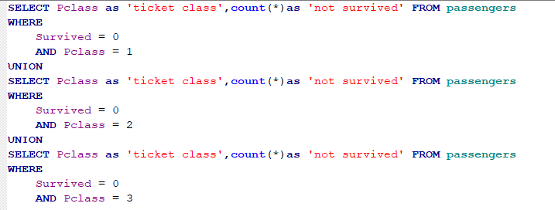
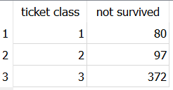
Output
SQL Query
This SQL query count the number of passengers from each ticket class that did not survive the incident.

Slide 22
Research questions
Data ANALYSIS
Are rich people have a survival rate because they can get onboard to the rescue boat sooner? Based on the analysis, the first-class passengers that survived the incident is 136 out of 216. As for the second-class, there are 87 out of 184 passengers that survived. As for the third-class, there are 119 out of 491 passengers that survived the incident. From that, the survival for the 1st class, 2nd class, and 3rd class are 62.96%, 47.28%, and 24.24% respectively.

Slide 23
Conclusion: ANALYSIS RESULTS
VARIABLEs | Total passengers | Total passengers | Survival rate (%)
Are children and elderlies have a high survival rate in this accident? | 47 | 47 | 42.55
Are females more likely to survive in this accident than males? (F-female/m-male) | F: 314 | M: 577 | F: 74.2 M: 18.9
Are rich people have a survival rate because they can get onboard to the rescue boat sooner? | 1st: 216 2nd: 184 3rd: 491 | –0.309 | 1st: 62.96 2nd: 47.28 3rd: 24.24

Slide 24
Conclusion
Data ANALYSIS
In conclusion, the females are more likely to survive the incident due to the high survival rate and has the highest compared to the other variables. Therefore, the movie might be true that the females get onboard the rescue boat first and same goes for the 1st class passengers since they have higher survival rate compared to the other classes passengers. However, the survival rate for the children and elderlies are quiet low which is below 50%. This can be concluded, that they were not prioritized this group to be rescued first.

